Slide 1
FIXMIX
Test after Run 3 15.05.2026

Slide 2
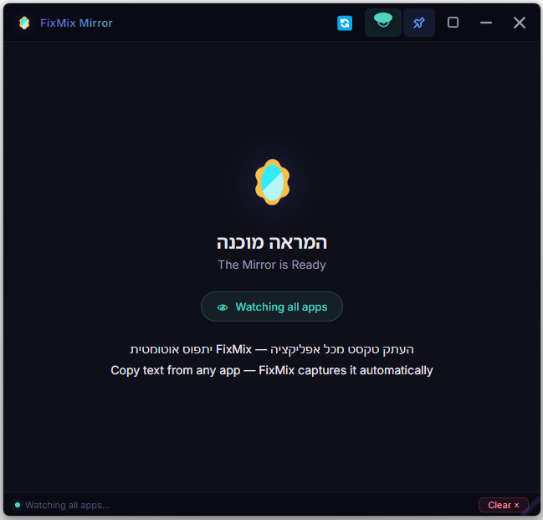
PHASE 1 — Planed Development Roadmap:
Add an automation feature that copies and pastes any new text generated in the selected chat window — no manual copy action required by the user.
Fix UI/UX per Tzafrir's feedback.
Build a Copy Text button and a Save Text button — define and develop supported export formats:
(Google Docs, Word, Google Sheets, Excel, PDF, or Markdown only)?
4. Show a confirmation dialog after clicking "Clear" — ask whether to save the text before permanent deletion, or implement auto-save for all content.
* Explore creating a local folder on each user's machine when FIXMIX is installed. Any text cleared from FIXMIX would be auto-saved there. (Can be developed before deployment.)
Current app status: all features working as expected. List of issues and proposed changes on next slide
Deep research about UIA: https://chatgpt.com/canvas/shared/6a0771a8fb8881918441b1f1ee71ee26

Slide 3
Bug fixes & open questions. List of problems and possible changes
1. Conflict with voice-dictation apps (e.g. Whisper Flow).
If the user dictated the first text into the app via a voice tool (before performing any manual copy), the window lock latches onto Whisper Flow instead of the intended target application.
Need to investigate: can voice-dictation apps be detected via clipboard events, and should text arriving from them be excluded?
2. Add a reorder toggle for text blocks — so users can swap the order of copied blocks (move a block up or down) if they copied them out of sequence before saving. Each pasted block in FIXMIX should have an up-arrow and a down-arrow icon; clicking swaps its position with the adjacent block. (See following slides.)
3. Artifacts & Canvases — when a table or text is copied from an Artifact: after any edit in the source app the entire Artifact is re-pushed to FIXMIX.
Why it matters: in the Artifact panel of the source app, edits happen in-place and the view persists. In FIXMIX, every minor edit re-renders the full Artifact from the top, requiring a scroll-down. That is acceptable, but it implies:
When building the copy/save feature in FIXMIX, we will need a region- or block-selection UI so the user can choose what to copy/save before acting. (See following slides.)
It is unclear whether — or how — this will work once the UIA automation feature is built, because no new clipboard event is generated when the source app edits an Artifact in-place.
General note (not limited to Canvas): when new text is appended below the visible area in FIXMIX, the user gets no feedback that new content exists and needs to scroll. We need a solution — ideally a user-configurable option: auto-scroll on new content (like most AI chat tools) vs. no auto-scroll, but with a persistent visual indicator at the bottom of the screen showing that there is more content below. Even better: a small badge next to that indicator counting how many new blocks have been added below the fold.
4. more UI update in the next pages and images at this same folder
C:\Users\ortsa\Dropbox\Apps and agents building\FixMixAI\project-meta\Test Phase 1 After RUN 3

Slide 4
If UIA auto works then we want to change the UX:
1. We don’t need to switch onq off the “eye” since we always using it.
2. We want to let user choose at the beginning of the journey to select: “I choose” option or “Auto All” option. In option 1 the user needs to copy in order for the text to fixed and display on FixMix.
In option 2: All test is shown on Fix Mix.
So UI changes:
“Eye” icon always on- not on the top icons. It can go down the low part of the screen. And can we develop this “eye” icon as a monitor for the auto pasting. + another icon for monitoring the auto copy in case user chooses “Aoto all”- out of this logic we need to notify user if one of them is not working, and to write notification what do.
The main UI changes as in PNG: C:\Users\ortsa\Dropbox\Apps and agents building\FixMixAI\project-meta\Test Phase 1 After RUN 3\new UI if auto copy will woirk.png

Slide 5
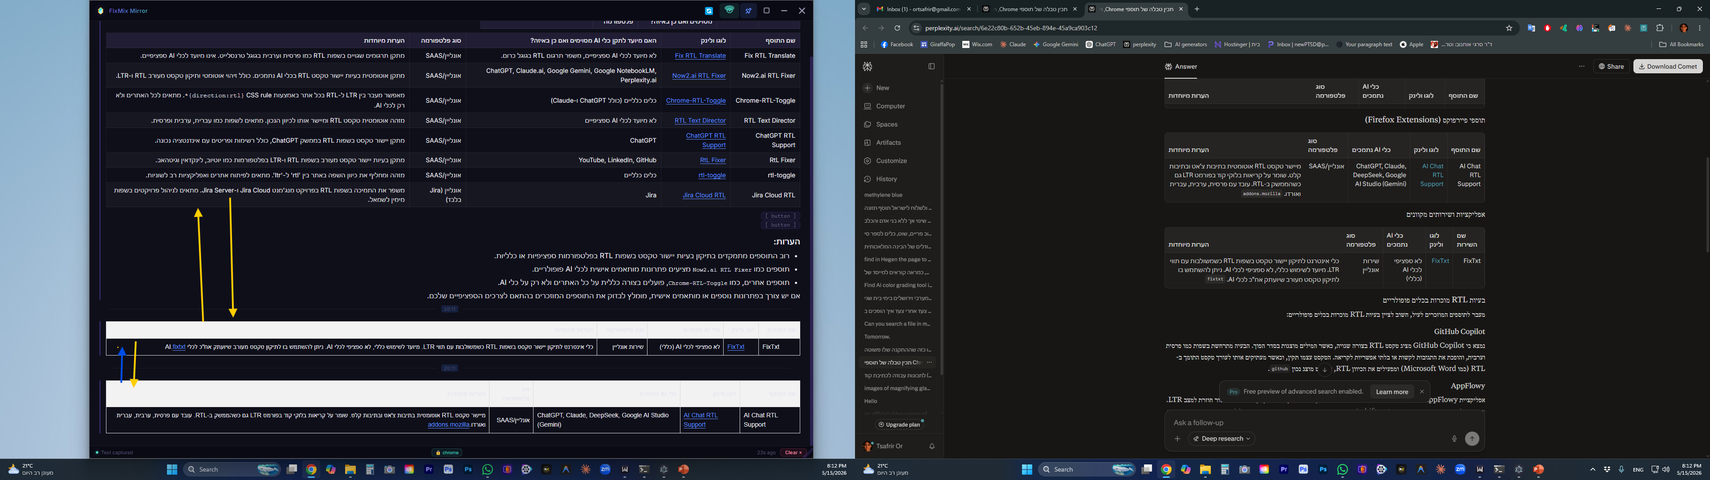
New UI (1): on each text at FixMix: change text block with the one above Or change it with the one below
See screenshot: “swich top down” l
FIXMIX app
Original app

Slide 6
FIXMIX app
Selecting “save or copy” area
New UI (2): Before saving or copying from FixMix the user need to choose the text blocks or the part to save/ copy. How can we develop it and what UI UX can we add? The “selection of what to save or copy” could be shown only after users clicked the future “Save” Or “Copy” bottoms
New UI 3: LTR text rendering — see screenshot at the PNG: PNG name: “Less left alignment to LTR text”
"C:UsersortsaDropboxApps and agents buildingFixMixAIproject-metaTest Phase 1 After RUN 3Less left alignment to LTR text.png“

Slide 7
Research: After developing the automation feature- Can Artifact or Canvas Auto copy changes automatically?
Is there a solution via a UIA update event?
Attached research covers:
What types of data flow through UIAutomation
The semantics of each data type
Whether it is logical / graphical
How stable it is
What doesn't pass through UIA at all
Also included — a Pipeline and analysis of:
Pull vs. Push
Why AI Agents rely on it
Where it breaks in modern UI stacks (Electron / Canvas / Games, etc.)
https://chatgpt.com/canvas/shared/6a0771a8fb8881918441b1f1ee71ee26

